Slide 1
Week 10 Updates Shapiro
By Evan Johns

Slide 2
Athena Supplemental Figure Analysis
Misaligned figures likely responsible for a large portion of the error that we are observing.
TMA Core C has much stronger correlations between the protein and mRNA data than TMA Core A. Likely because TMA Core C has better alignment.

Slide 3
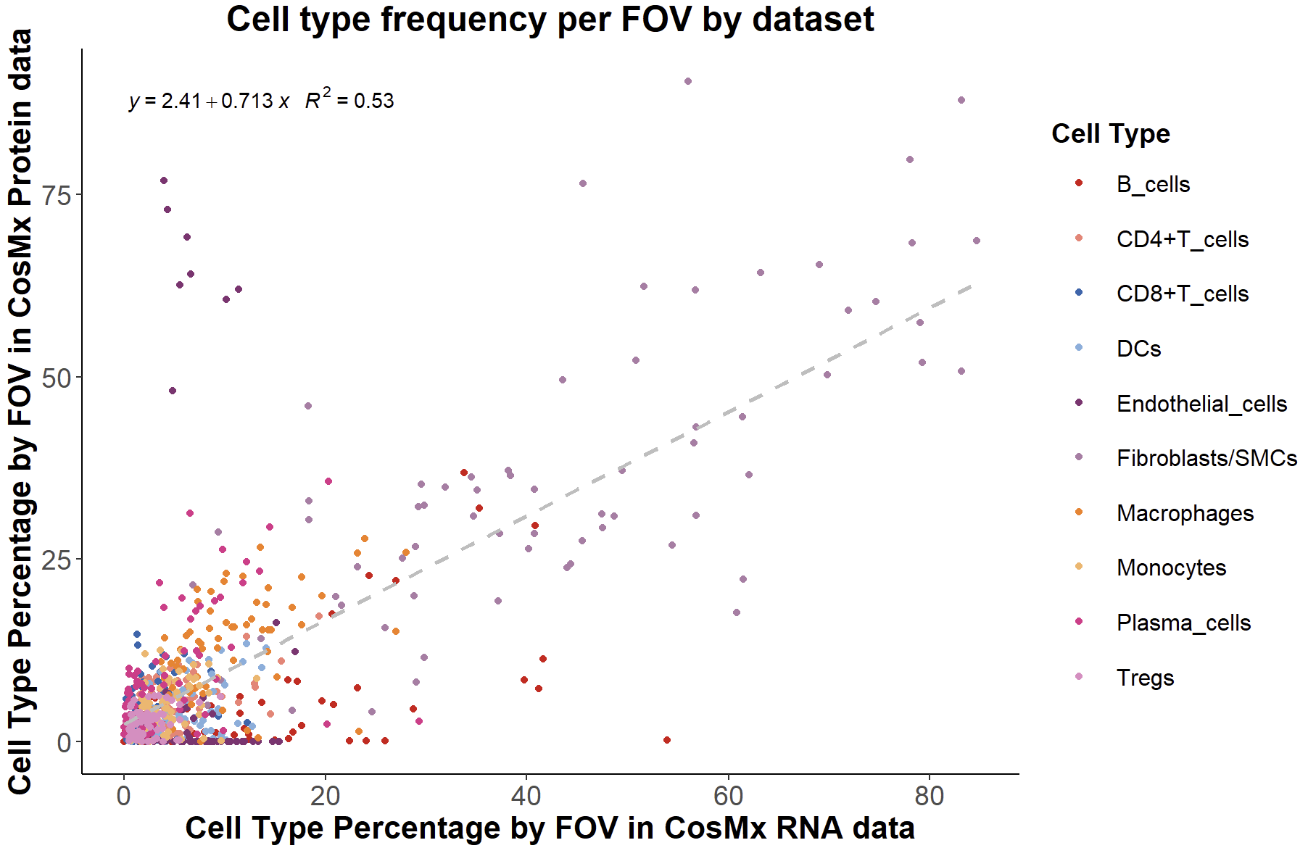
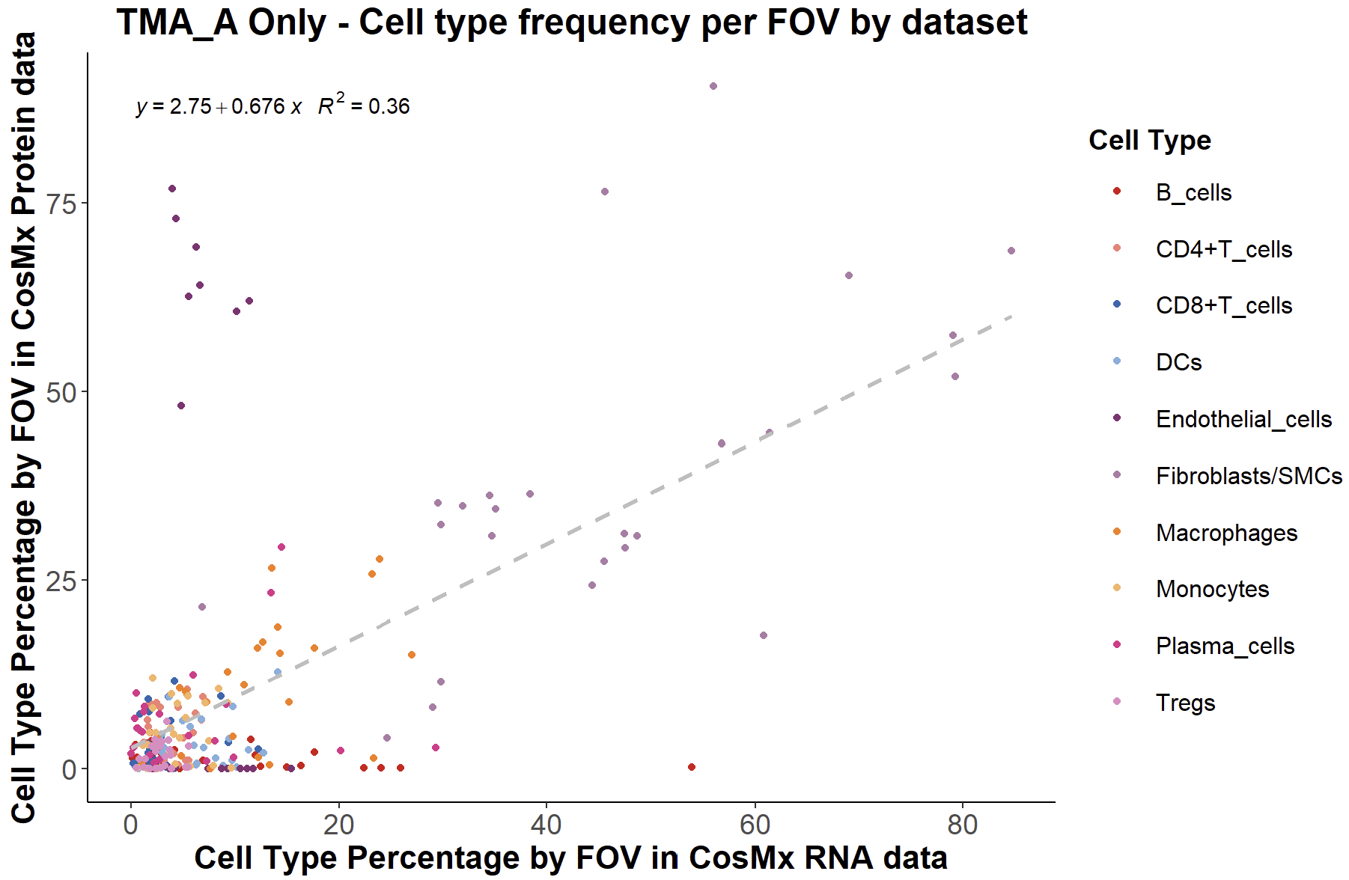
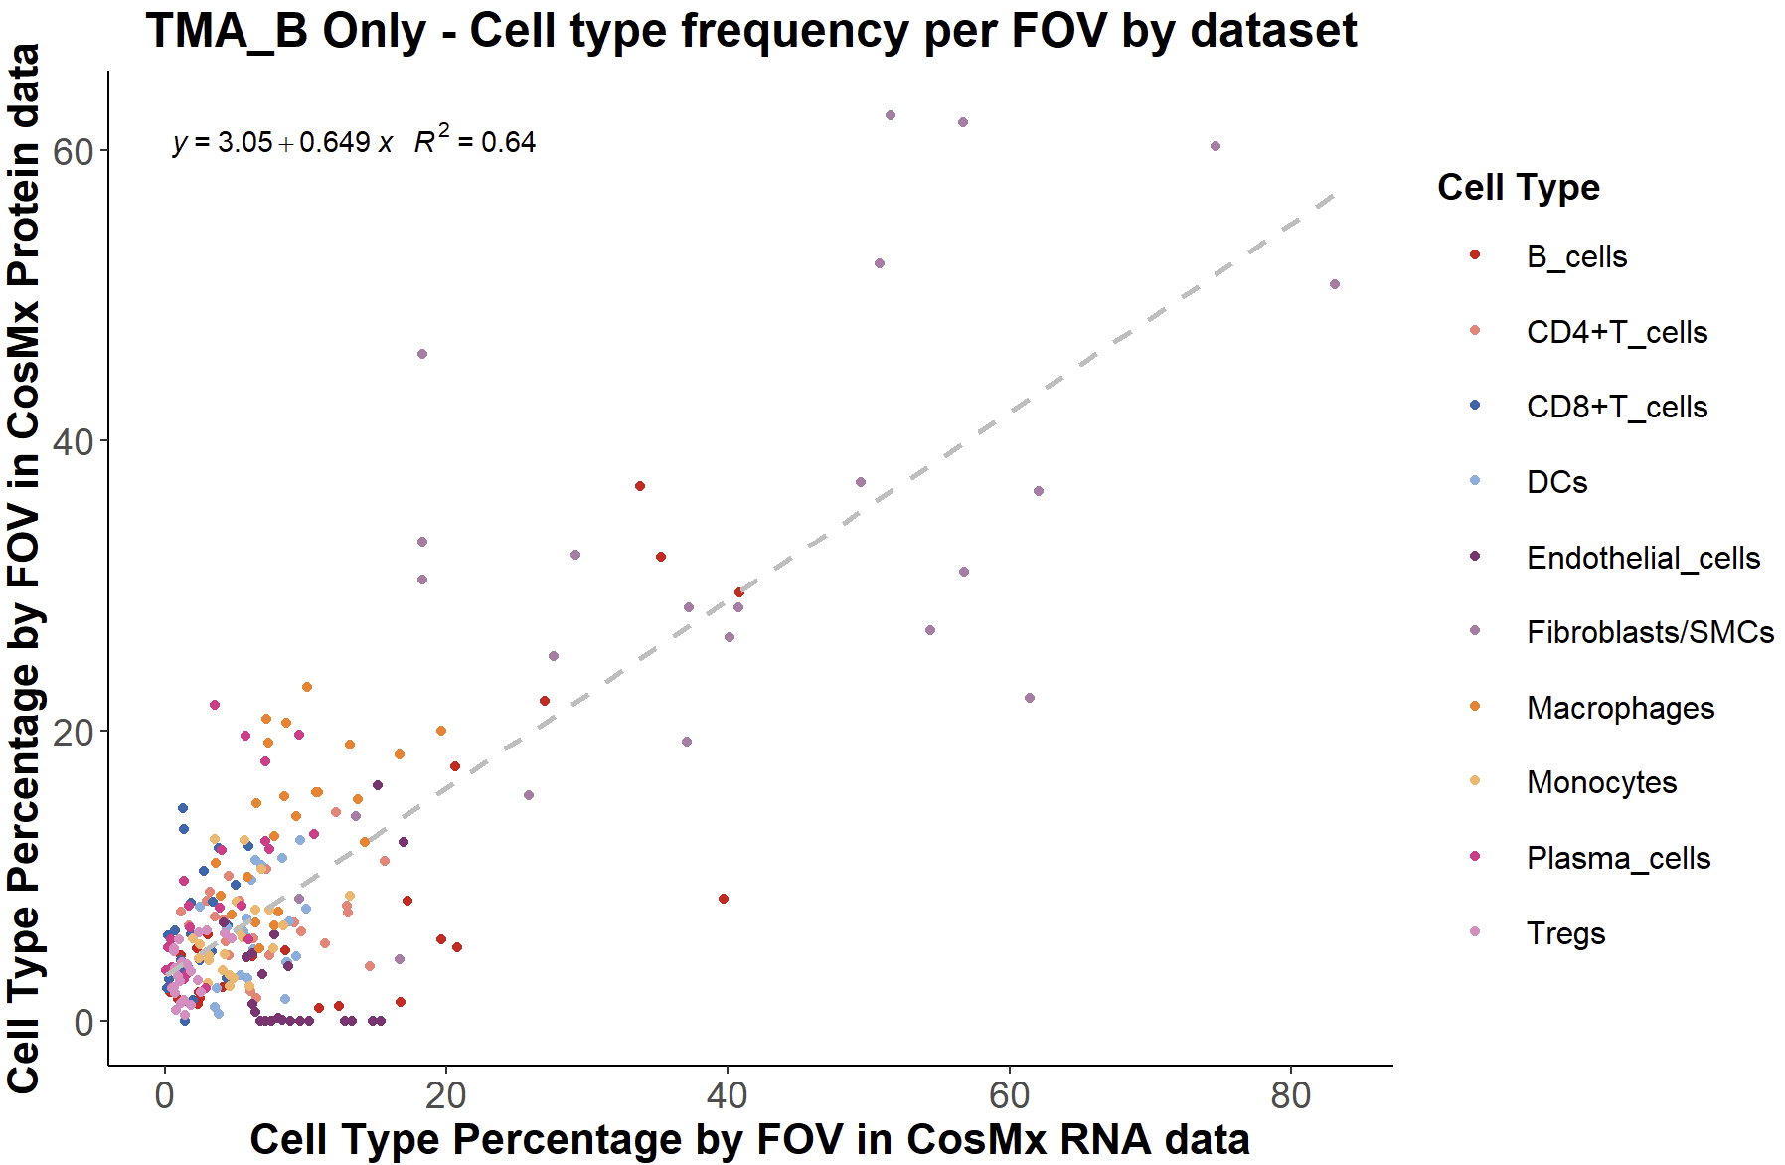
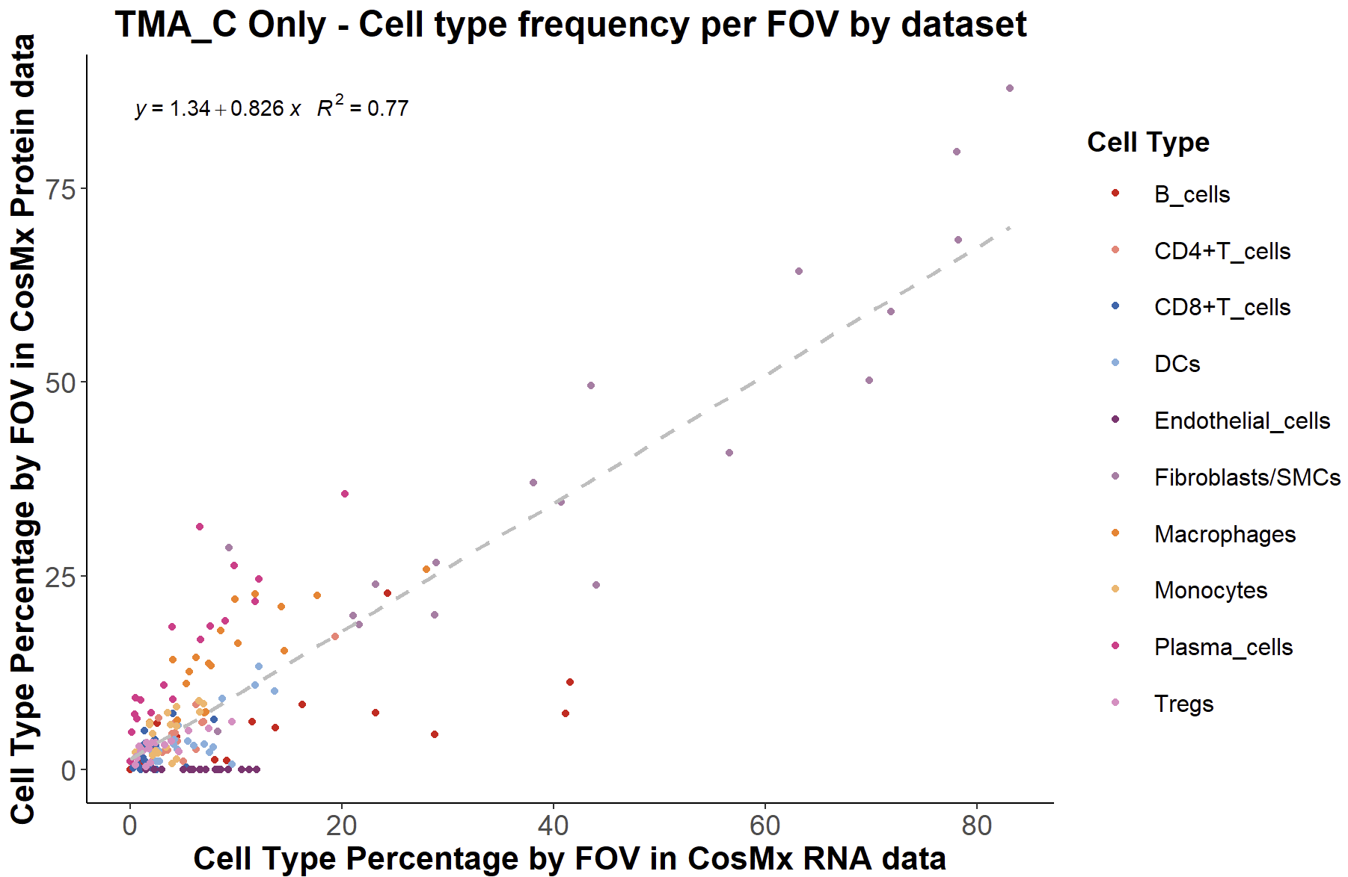
Supplemental Figure Analysis

Slide 4
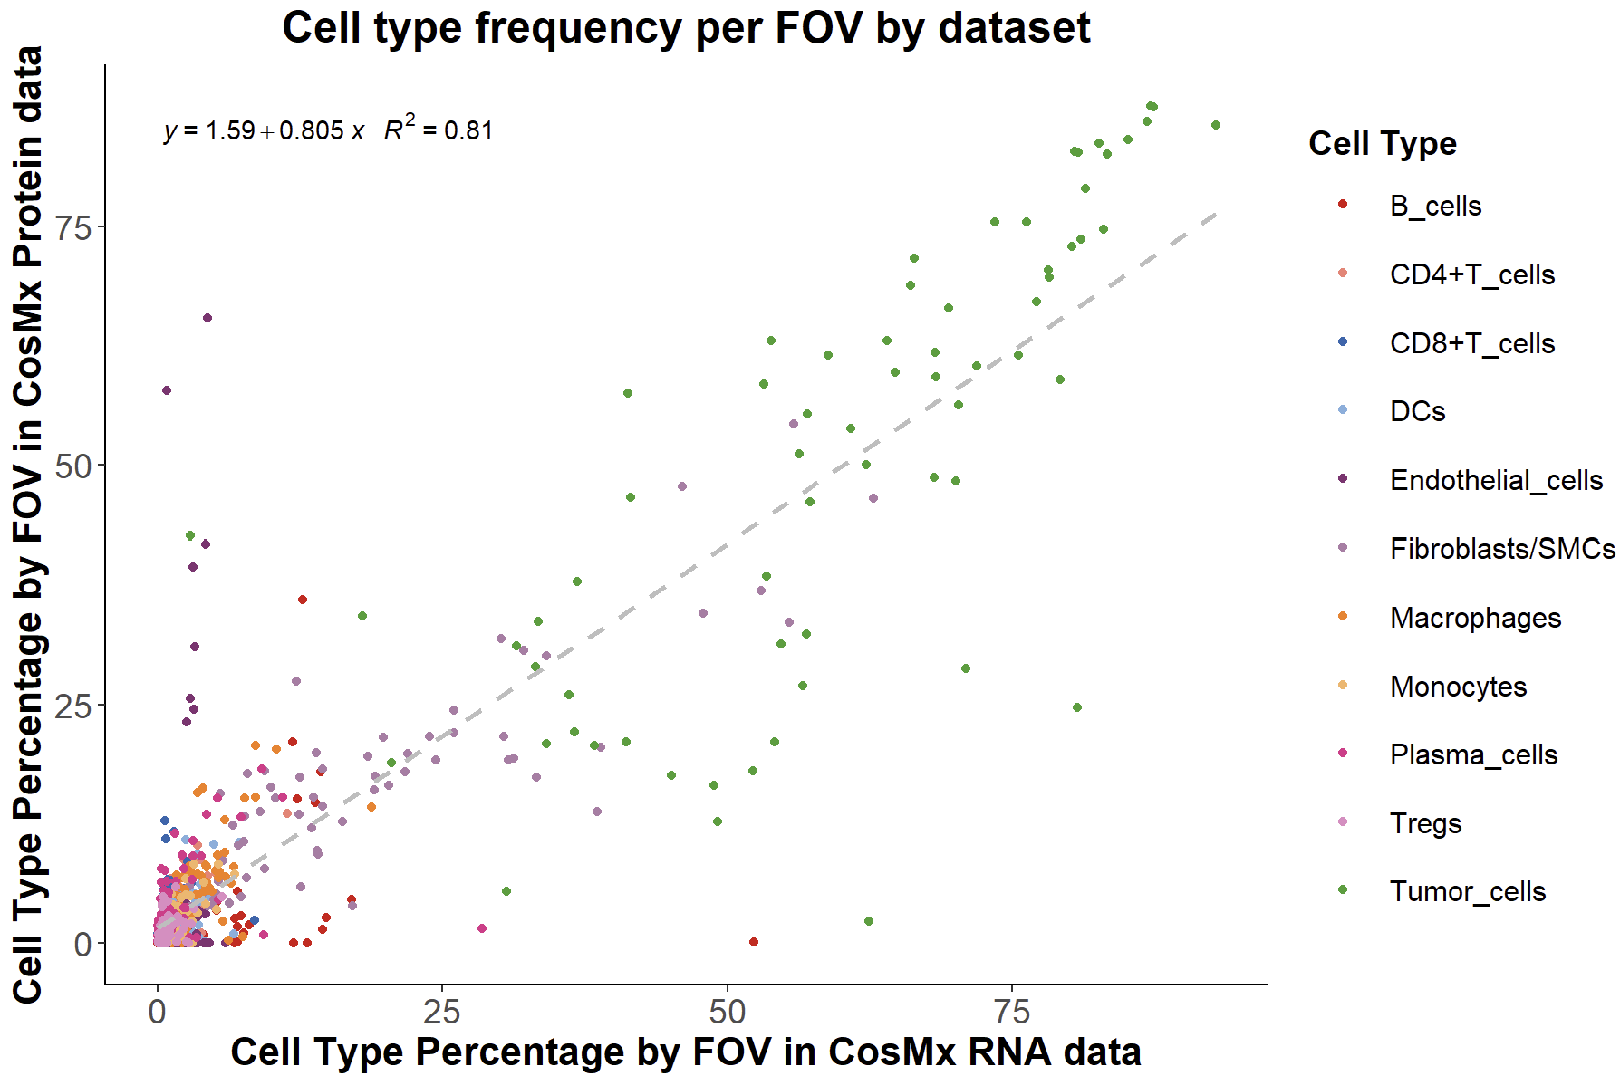
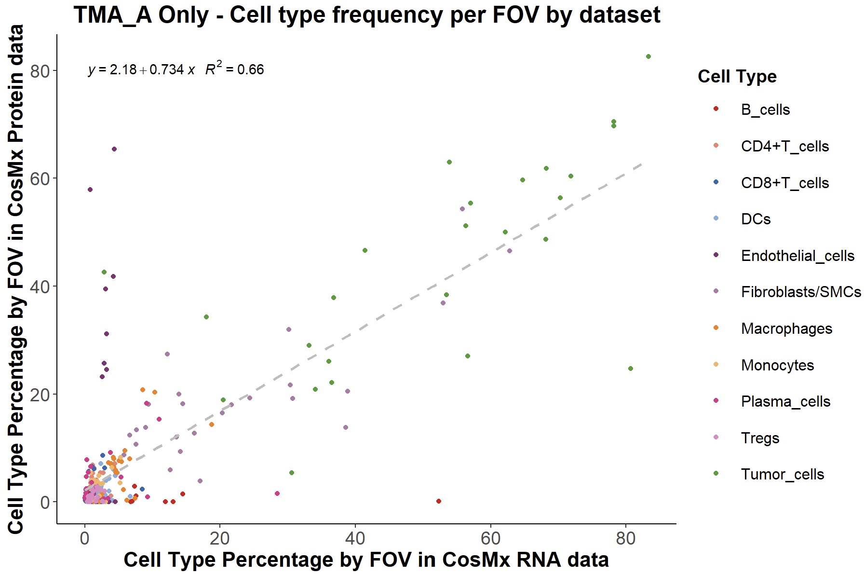
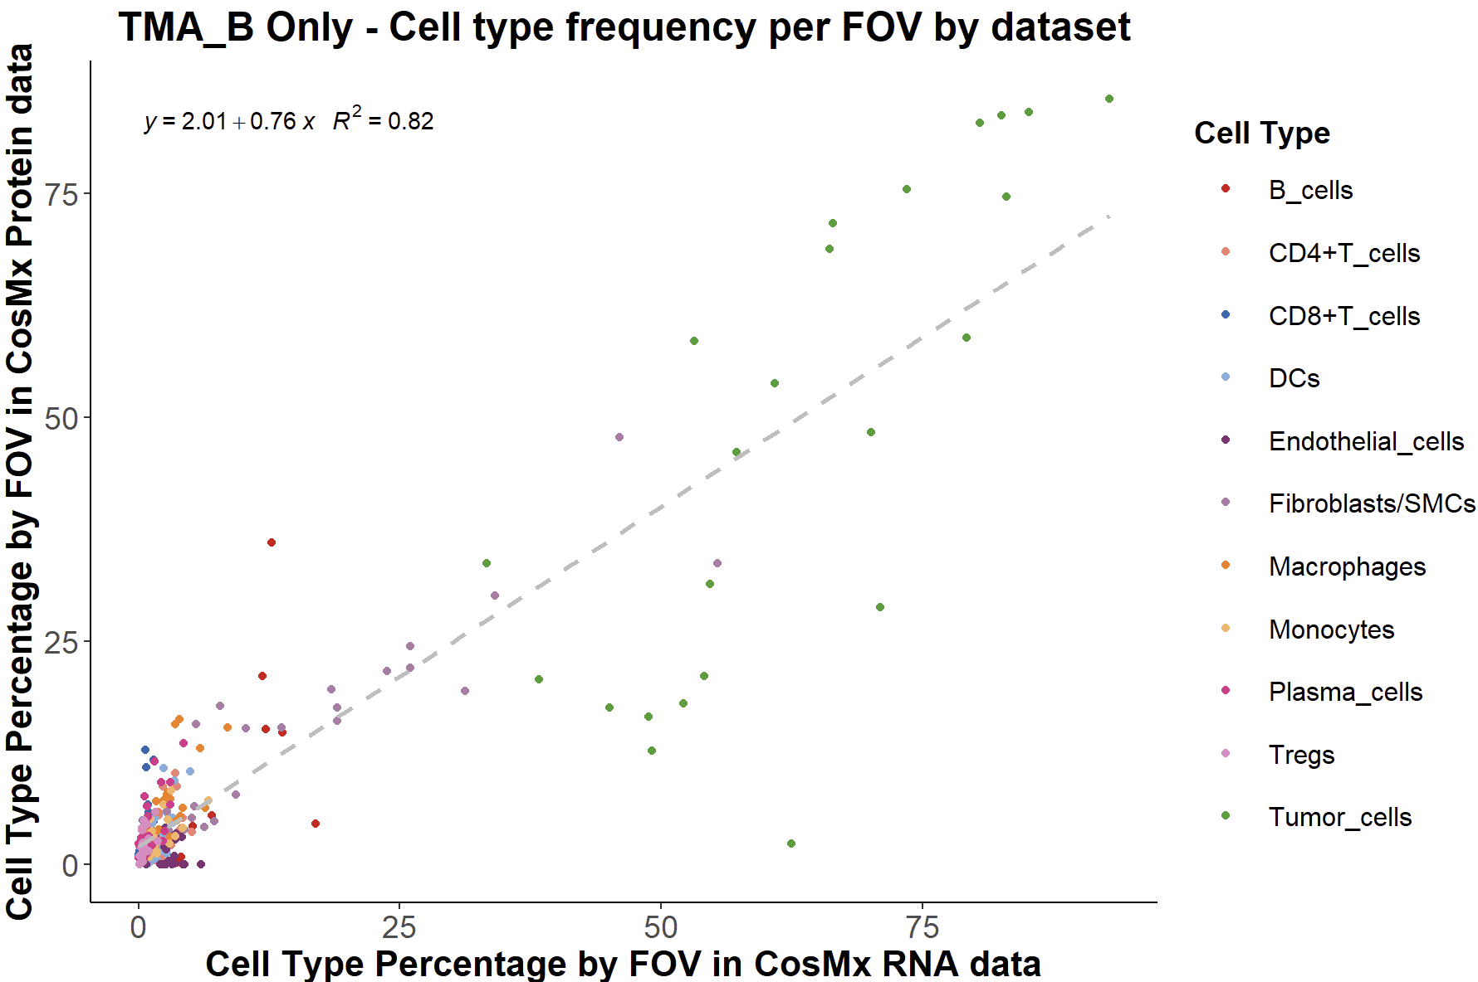
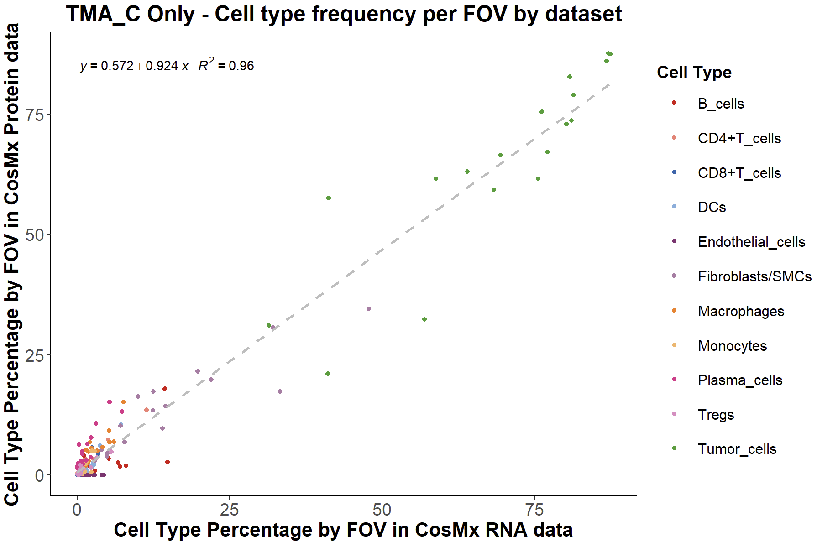
Supplemental Figure Analysis

Slide 5
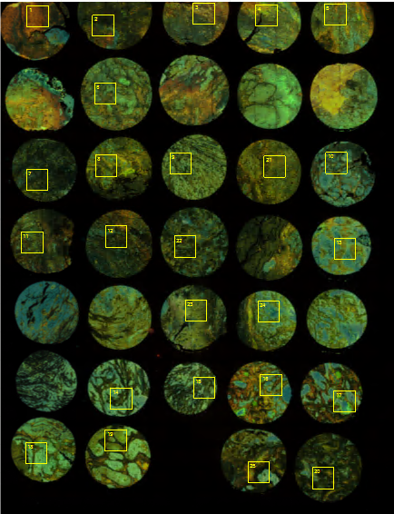
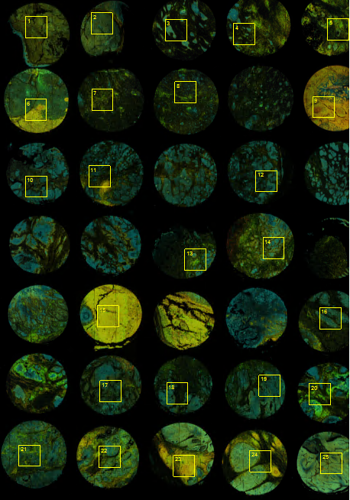
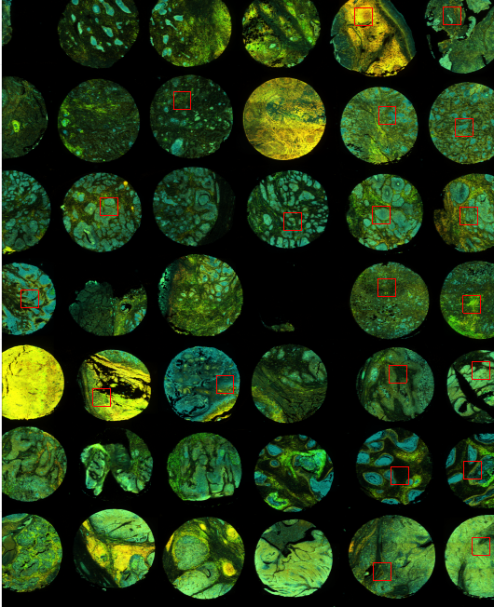
TMA CORE ALIGNMENT Protein
protein TMAA
protein TMAB
protein TMAC
Text

Slide 6
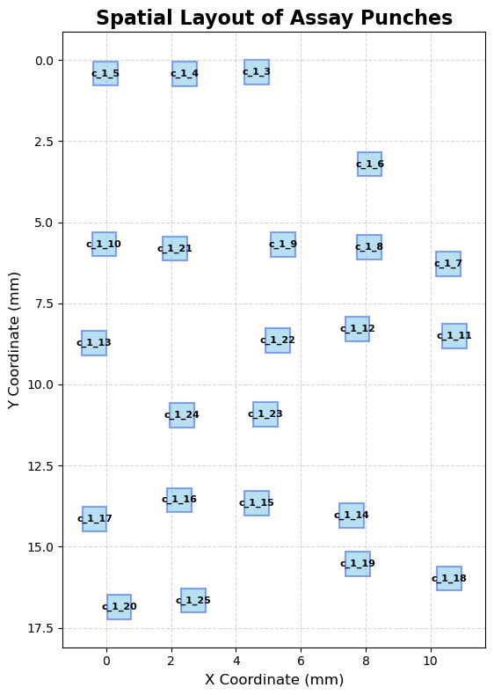
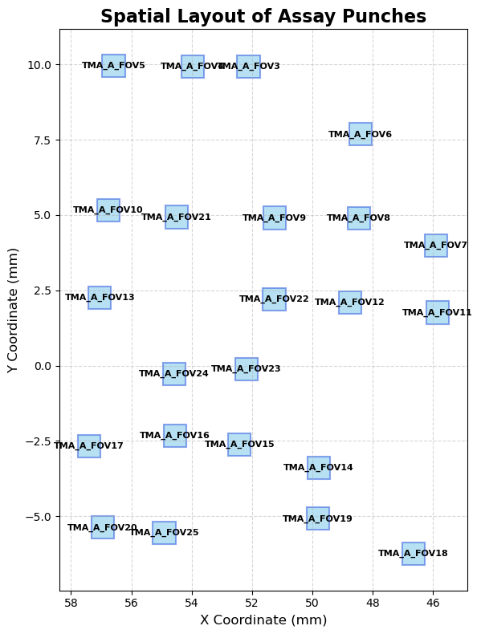
TMA A Rectangle Comparison
Protein
mRNA

Slide 7
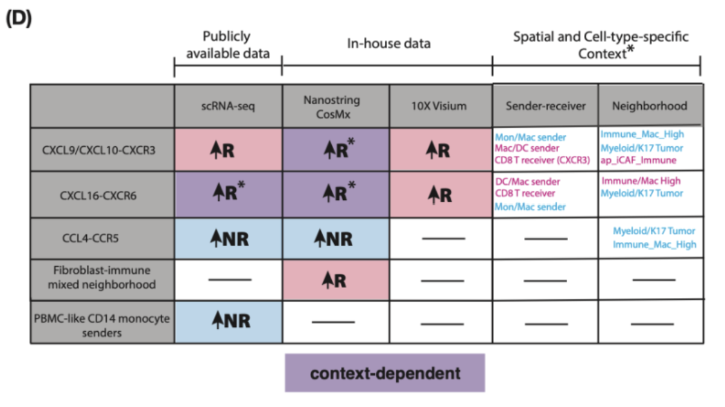
Ligand Receptor Colocalization Analysis

Slide 8
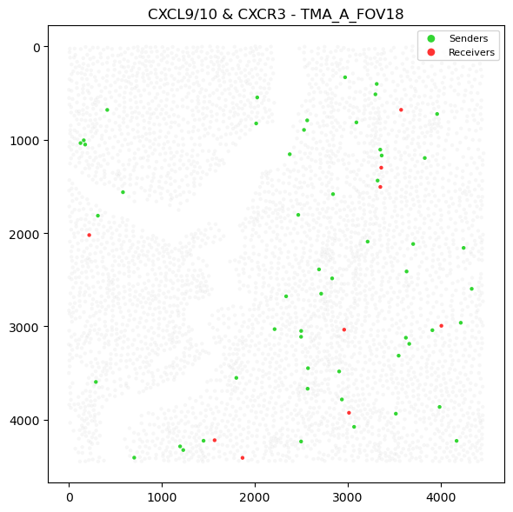
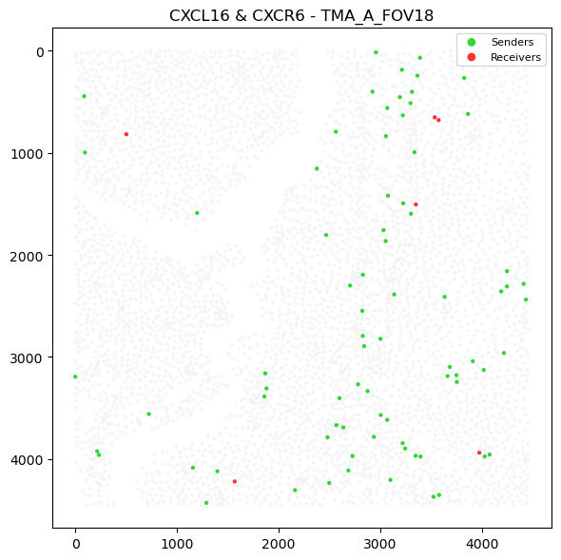
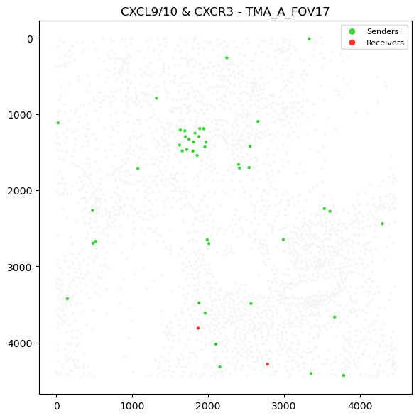
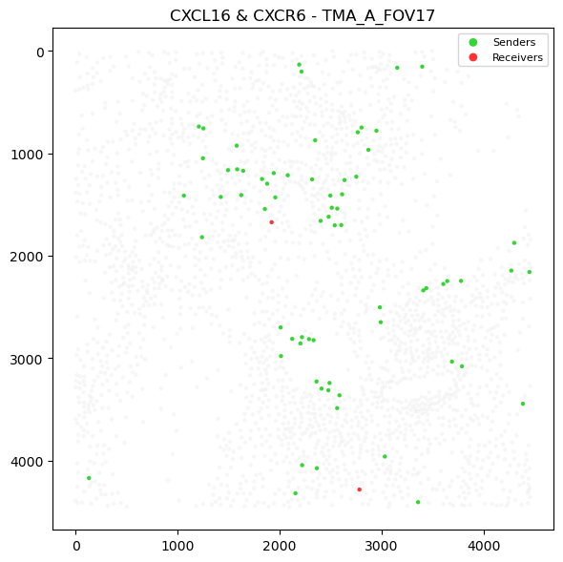
Ligand and Receptor Analysis

Slide 9
